Slide 1
Announcements
Weds. March 10th BISD Early Release Day
Spring Break March 15-19
Weds. March 24th from 9-1 PSAT for 9th and 10th Graders
PSAT Study Guides are available in the library
or online at Khan Academy
Weds. March 31 BISD Early Release Day

Slide 2
Adulting 101-Renting an Apartment
Common words:
Landlord- person who owns the property.
Lease Agreement or Lease- a legal contract between the landlord and renter that covers the length of time, price, and services included ie electricity, water, garbage, internet. If the renter or landlord breaks the lease, they may be forced to pay a fine or even go to court.
Rent- monthly payment made to the landlord.

Slide 3
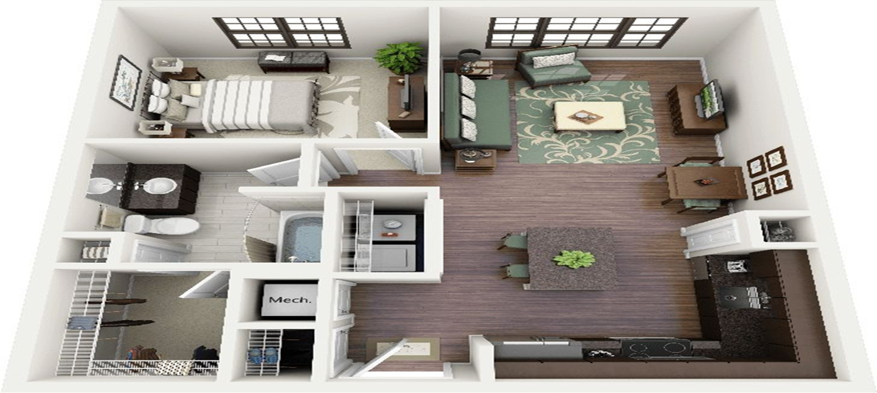
Adulting 101-Renting an Apartment
You can get a lease for one month, three months, six months, or a year, with the most common being a year.
The shorter the lease, the more expensive the monthly rent since the landlord will have to find another renter.
For example
1 year- $1,200
6 months- $1,400
3 months- $1,500
1 month- $1,800

Slide 4



Adulting 101-Renting an Apartment
Why would a shorter lease be a good idea?
You are moving to Chicago for a new job. You have only been to Chicago a few times for the interview and a vacation. You get a 3 month lease, which gives you time to explore the city and perhaps find a better located or more affordable apartment.

Slide 5
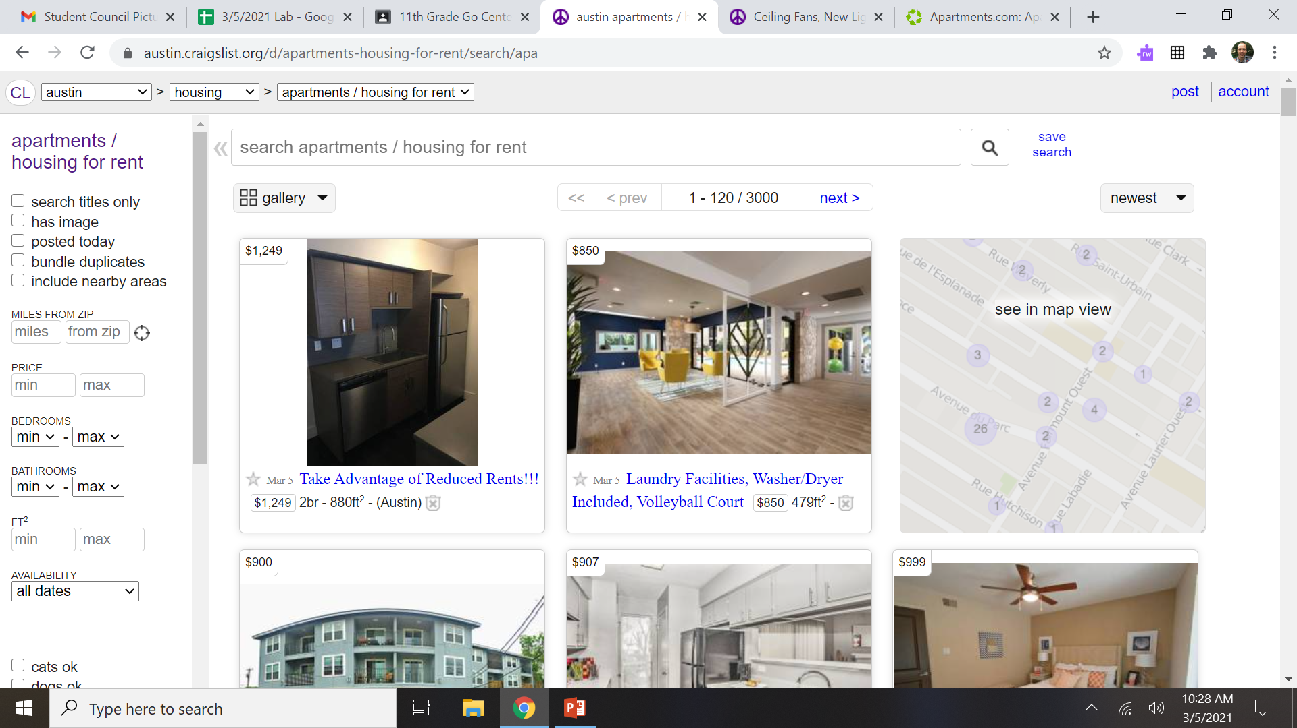
Adulting 101-Renting an Apartment
Available apartments can be found on Craigslist, apartments.com, in the paper, or just walking around.
Do your research and always tour the apartment before renting it.

Slide 6
Adulting 101-Renting an Apartment
Common Terms:
Deposit- amount you put down to reserve the apartment and in case any damage occurs. Can be first month’s rent, returned at the end.
BR- Bedroom, BA- Bathroom
For example: 2BR, 1 BA means 2 bedrooms, 1 bath
W/D Washer/ Dryer
Sqft or ft2- square footage (size) of the apartment
Pet friendly- may require a pet deposit (see above)
Studio Apartment- all rooms, except bathroom, are open and in one room

Slide 7
Adulting 101-Renting an Apartment
To Roommate or not to Roommate?
Pros:
The main cost of a rental goes into the kitchen and living room.
To have roommates is always the cheaper option than living alone.
For example 1 BR, 1 BA could be $1,200, whereas a 2 BR, 1 BA is $1,400 saving you $500. The more roommates the better 4 BR, 2 BA $2,000 equals $500 a person.
Cons:
You are sharing your space with another person.

Slide 8
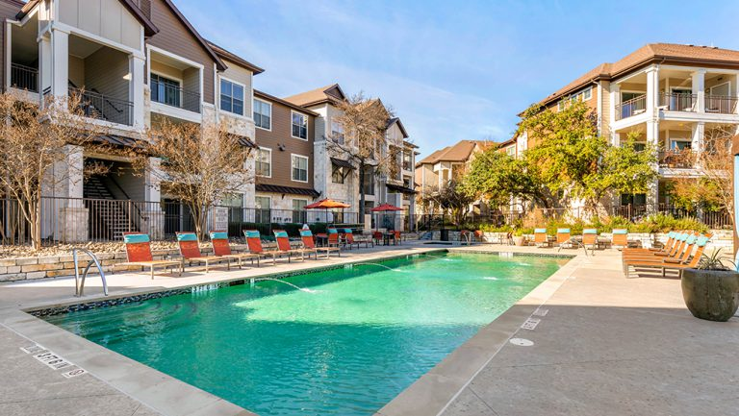
Adulting 101- Credit Score
https://austin.craigslist.org/apa/d/austin-ceiling-fans-new-light-fixtures/7272500563.html
https://austin.craigslist.org/apa/d/austin-the-perfect-place-to-call-home/7285549484.html
https://austin.craigslist.org/apa/d/austin-nw-apartment-community-with-nice/7281706093.html
https://www.smiforestcreekapts.com/
Here are some examples. The last one is an apartment that I lived in for two years.

Slide 9
Adulting 101-Renting an Apartment
Links for more information:
https://www.apartments.com/blog
https://www.allstate.com/tr/renters-insurance/different-types-of-apartments.aspx

